Slide 1

Weekly Connect Airsim + VINS
Ritvik Pandey
Intern H402743

Slide 2
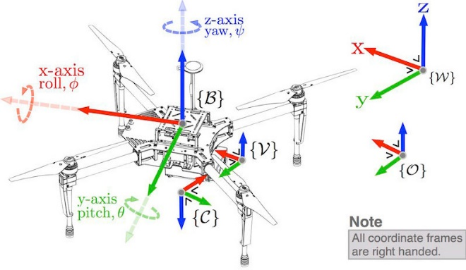
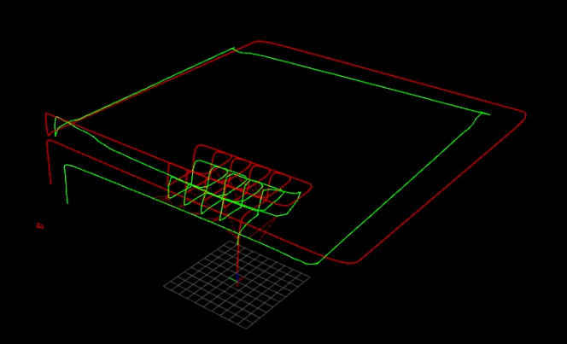
DIMENSIONS of UPDATES
Translation Error
Frequency test
Range of motion
Code Architecture
Error Plots
ArduPilot - SITL

Slide 3
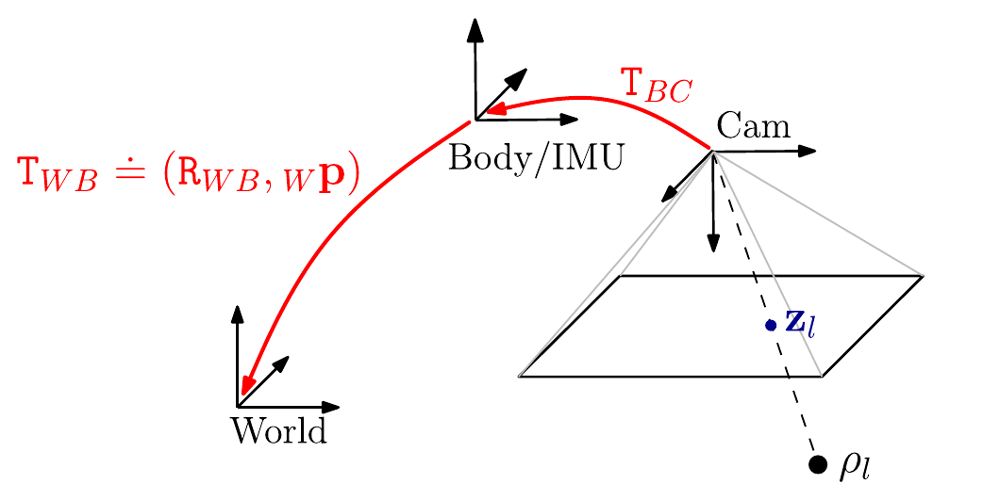
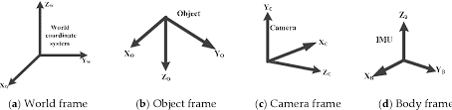
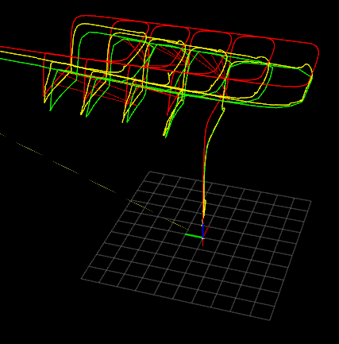
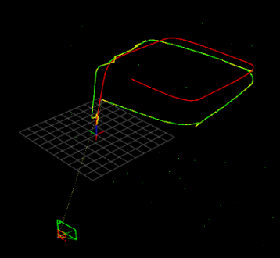
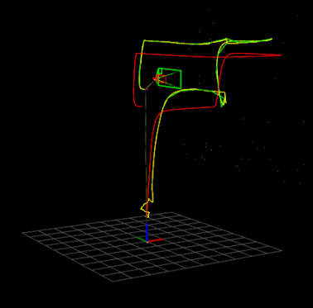
Translation error
Tweaks made:
IMU initial standard deviation check
Camera to IMU extrinsic co-ordinate fix (camera and IMU/body both follow a right-hand co-ordinate system but camera has +Z axis in forward direction while IMU has +X)

Slide 4
Frequency TEST
Range of motion
Tweaks made:
ROS wrapper publishing rate and delay duration changed
Disabled all checks for lidar and other sensors
Shapes tested:
Bigger rectangle (~200m perimeter) with no loop closure
Random directional motions 100-200m traversed.
Deviations become significant as path length is increased beyond that without loop closure
Could not test path lengths upto a 1-2 km as drone moves out of environment and looses all features.
IMU topic frequency | Image topic frequency | VINS output frequency
4 hz | 4 hz | 4 hz
20 hz | 4 hz | 10 hz
50 hz | 4 hz | 10 hz
20 hz | 15 hz | 10 hz

Slide 5
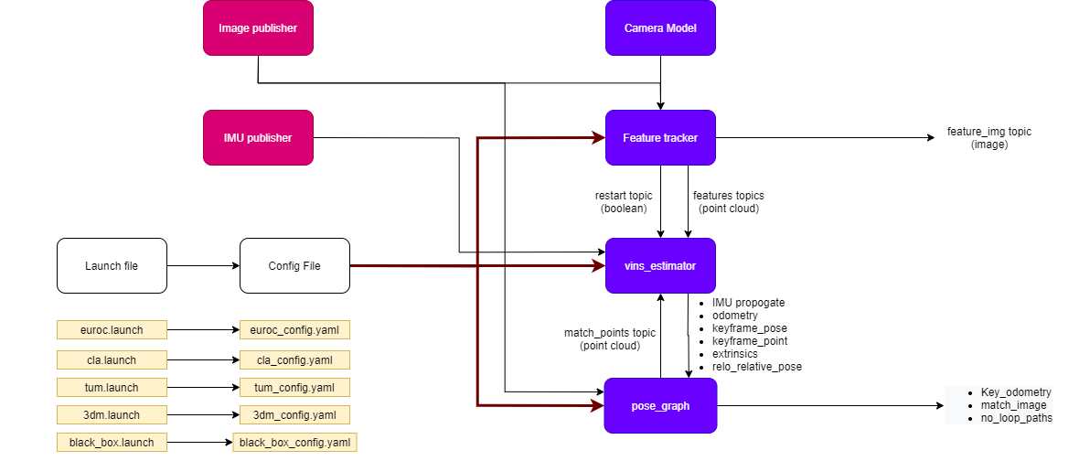
Code Architecture (VINS)

Slide 6
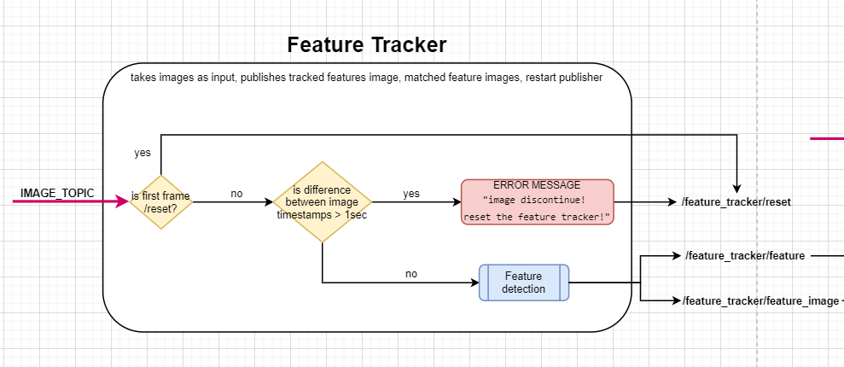
Code Architecture (VINS)

Slide 7
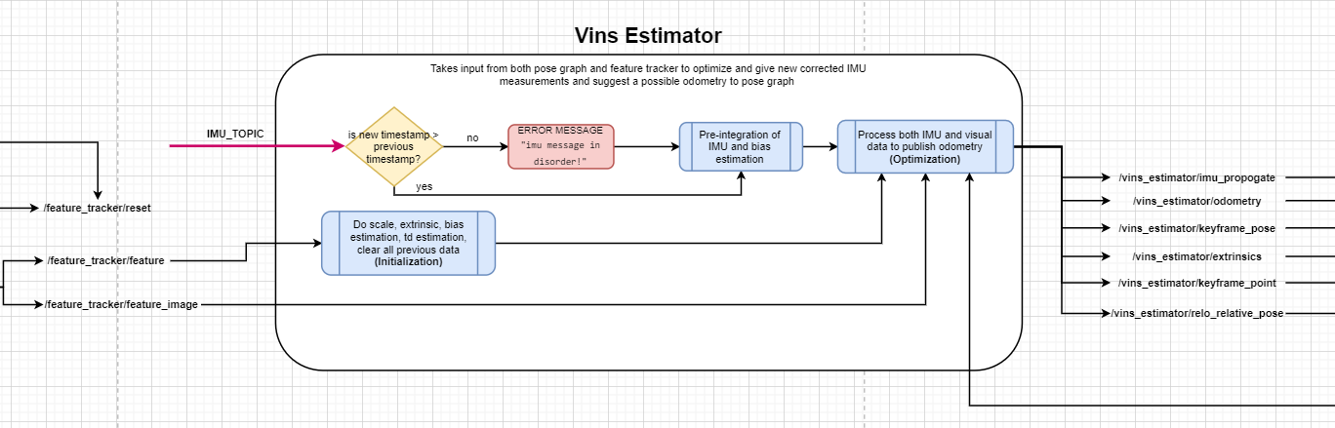
Code Architecture (VINS)

Slide 8
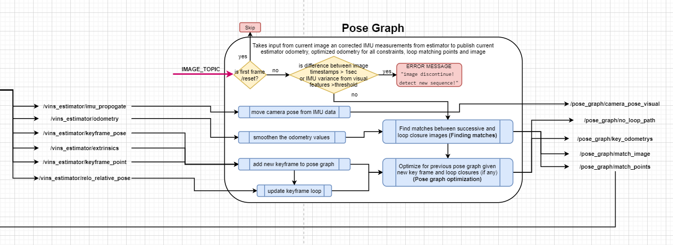
Code Architecture (VINS)

Slide 9
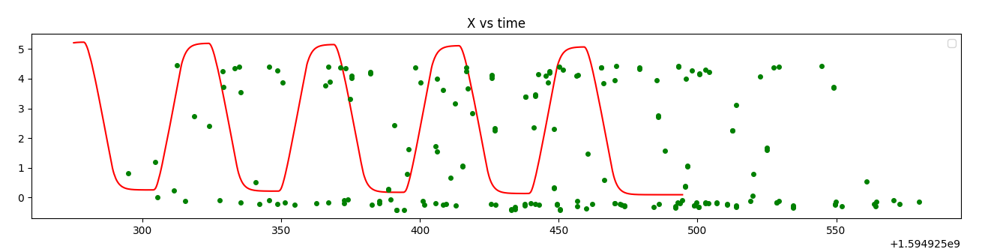
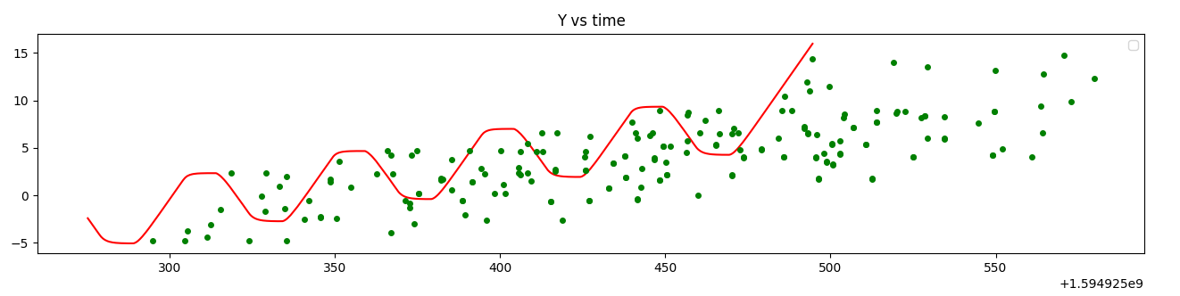
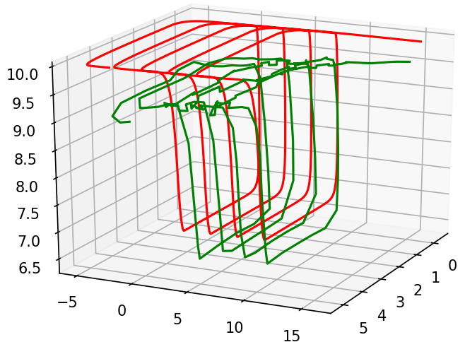
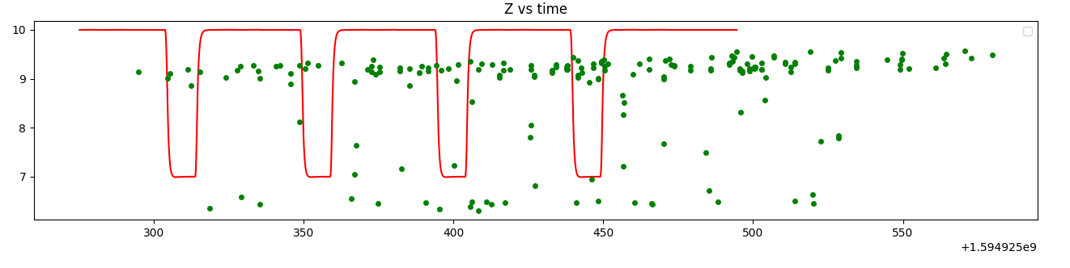
Error Plots
Red: Ground truth
Green: pose-graph estimates
The ground truth is published at much higher frequency (150hz) and VINS output is set to publish at 10hz hence it was better to show it as points and not zigzag lines

Slide 10
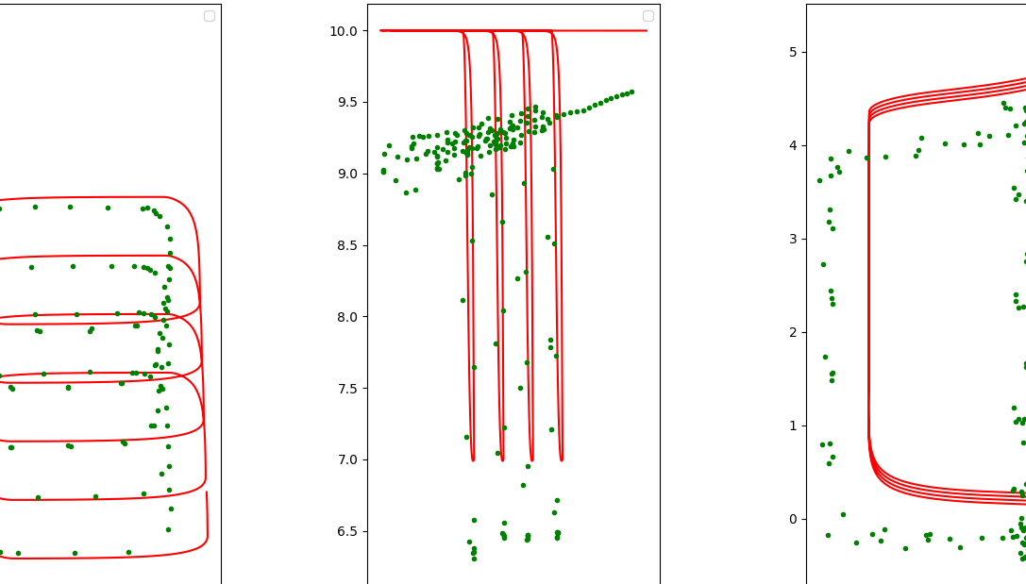
Error Plots
Red: Ground truth
Green: pose-graph estimates
The ground truth is published at much higher frequency (150hz) and VINS output is set to publish at 10hz hence it was better to show it as points and not zigzag lines

